Slide 1

Techno-rIoT
Agro-rIoT
Redefining agriculture with IoT

Slide 2


The Problem
Farmers have to go to the fields in scorching heat and shivering cold, and have to be physically present there during irrigation periods even at night.
Inefficient irrigation results in bad yields that weakens the farmer’s financial condition and increases the price of the harvest.

Slide 3

What’s in Our Mind
We want to change the whole irrigation system with IoT. System will process the collected data, giving prediction about the irrigation requirements of the field
Efficient use of water resources.
Automation using Machine Learning.

Slide 4

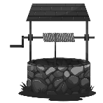


The Implementation
Field #01
Water Level Sensor

Slide 5

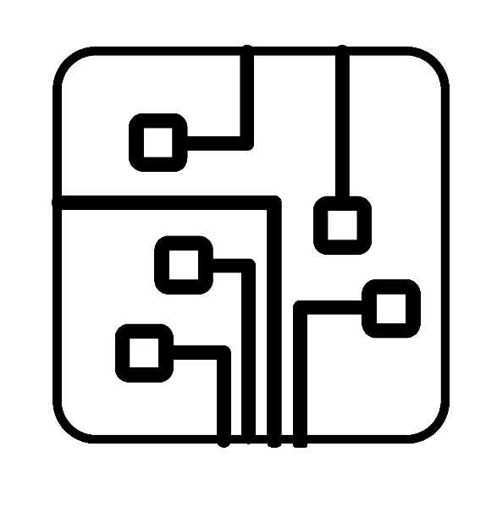

The Implementation
Info
Arduino
Cloud Server

Slide 6



The Implementation
Cloud Server
App

Slide 7
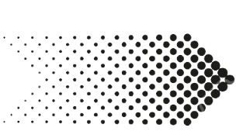

The Implementation
App
Cloud Server
Arduino

Slide 8

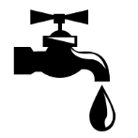
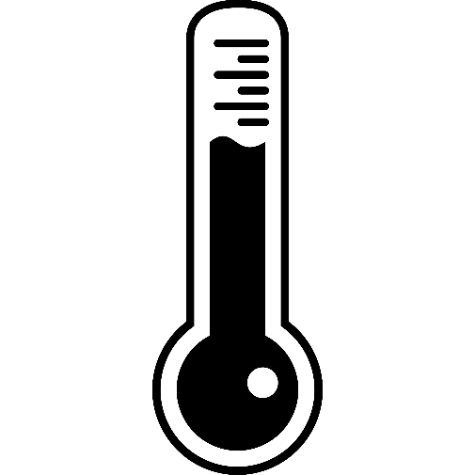
The Infrastructure
Soil Moisture Sensor
Cloud Server
Arduino
Water Level Sensor

Slide 9

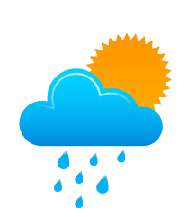
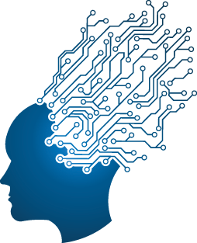

Future is golden
Machine Learning
Higher
Efficiency
Whether Forecast
Data

Slide 10
Thank You

